Slide 1
Applying Library Science Models to the Arrangement of Language Collections
Hugh Paterson III
&
Sergio I. Coronado
Hugh Paterson Ⅲ & Sergio I. Coronado. 2025. Applying Library Science Models to the Arrangement of Language Collections. Paper presented at the 9th International Conference on Language Documentation and Conservation (ICLDC). University of Hawaiʻi at Mānoa. March 6th–9th. Presentation slides Copyright 2025 by the authors. Licensed: CC-SA-ND.

Slide 2





Outline
Context & Relation
Problem Statement
LS Models/Examples
Benefits of Models
Notes:
IMLS is like the NSF for Libraries, Archives, and Museums.

Slide 3
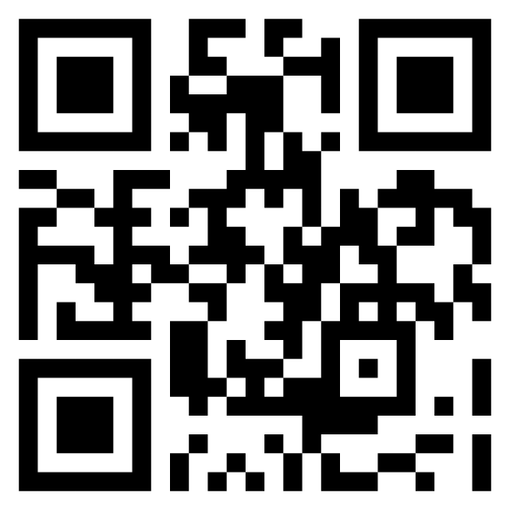
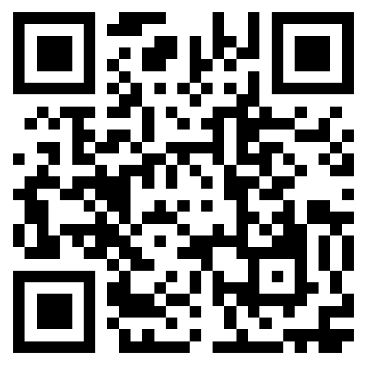
About Us
Hugh J. Paterson III
Sergio I. Coronado
University of North Texas & Institute for Advanced Study
hugh4.us
University of North Texas & Texas A&M University www.sic.bio

Slide 4
Context
Stemmed from
Institute of Museum & Library Services
(IMLS) Project
(partial sponsorship)
Allowed for the development of the LAMlangArc Training Project
Contributed to open-access course modules (presentations, readings, etc.)
Grant no.
RE-254860-OLS-23
ci.unt.edu/
lamlangarctraining
Course
Description
Notes:
IMLS is like the NSF for Libraries, Archives, and Museums.

Slide 5
How LS Models Relate to Language
Limited awareness and training about digital language archives in Libraries, Archives, Museums (LAM) education programs at universities in the United States.
This project-developed course helps fill that gap using content from professional readings and existing online language archiving training programs (ELDP, AFF, CoDA).
The course includes preparation of future information professionals on applying library science models when working with language collections

Slide 6
Problem Statement
How can existing LS models developed by LAM be applied to language documentation resources for curation in digital repositories to support discovery and use?

Slide 7
Library Science Models
3 models used to support arranging cultural heritage collections
IFLA-LRM
RDA
WEMI
Conceptual Entity-Relationship Framework (focuses more on resource relationships)
Data Content Standard (guides the building of entity-relationships)
Entity Levels for Bibliographic Description (supports the making of relationships)

Slide 8
WEMI Model Focus
Focusing on WEMI mainly as it serves as the foundation within the other library science models for creating groups of resources based on their relationships to each other.

Slide 9
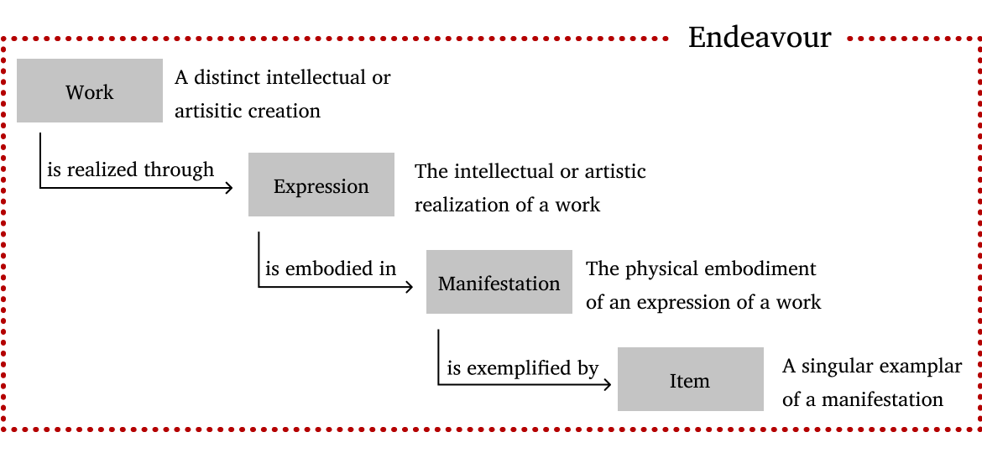
WEMI Definitions and Relations

Slide 10
Language Resource WEMI Example
Work
The Conceptual Content
The Pear Story
Expression
A Specific Realization Form of the Work
The Retelling of the Pear Story by Angam
Recorded video on film/.mov (file format)
Manifestation
Physical or Digital Form of Expression
Two copies in different collections
Item
Individual physical/digital copy of the manifestation within a collection

Slide 11

Hugh’s Part
Play Video
10 mins (8:45-19:56)

Slide 12
Examples of Types of Works, Expressions, and Manifestations
Reasons for designating language resource as a new type of
Work
Expression
Manifestation
Monographic Works
Compilations
Composite works (edited volumes)
Whole
Portion
Translation
Trans-media’d
High quality audio capture (source)
Compressed version (distribution)

Slide 13


WEMI Application
Some examples of how WEMI would be applied
For two common relationship types
Part-Whole
Collection of Whole Units

Slide 14
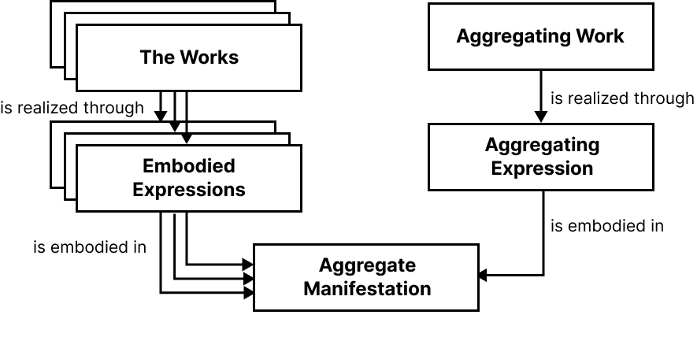
Aggregate Works
Edited Volume
CD with several Tracks
DVD with several episodes

Slide 15
Application to Language Resources
Some examples of how WEMI would be applied to records
For two scenarios
Legacy Audio Recording
Audio Recording
which has been digitized
with an accompanying transcript.

Slide 16
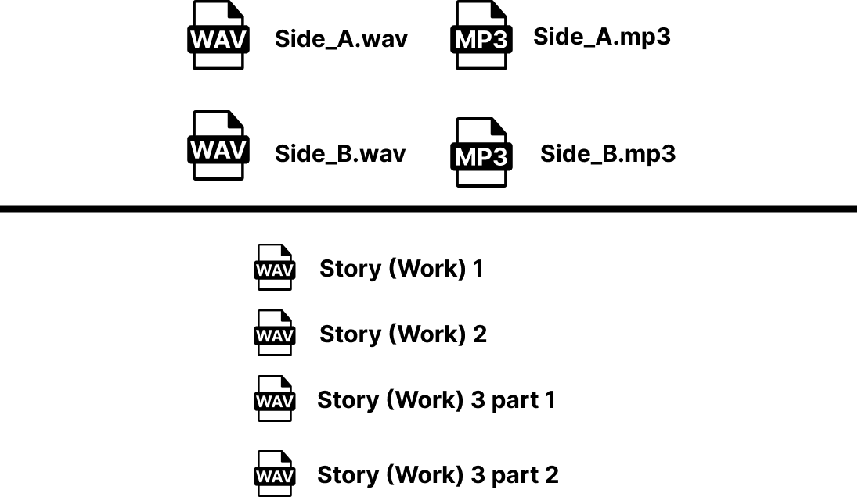
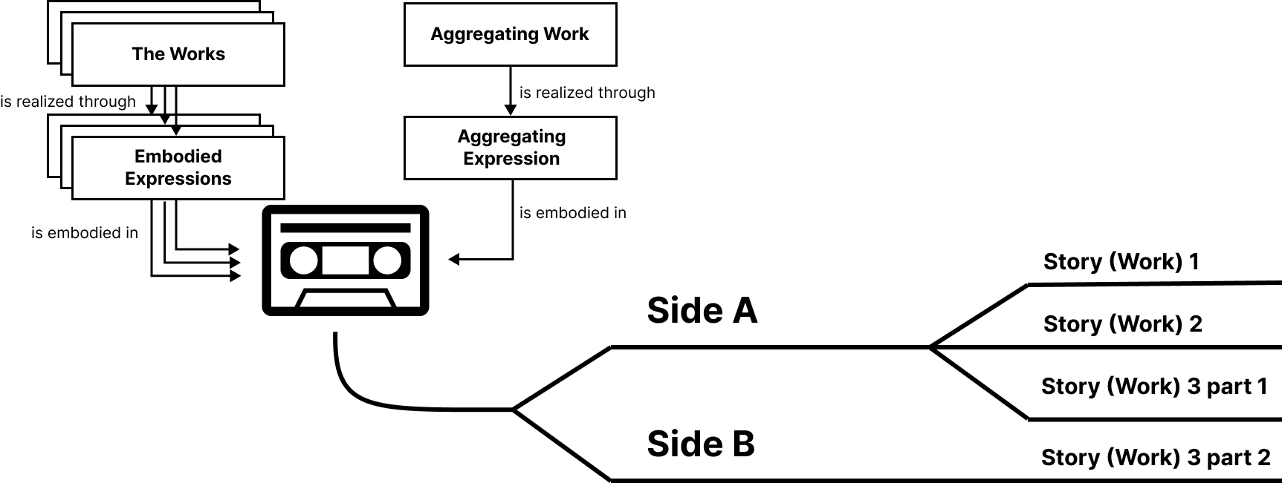
Language Documentation Example 1

Slide 17
Transcriptions & Annotations
Work or Expression?
Based on WEMI-based Models
Transcription
Annotation
Highly likely a New Work because of the analysis going into the transcription system. Minimally a New Expression.
New Work

Slide 18
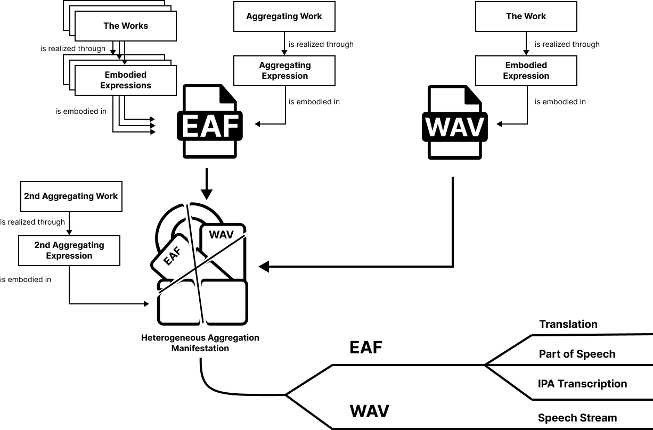
Language Documen-tation Example 2
Notes:
Spelled out acronyms on this slide: {PLEASE ADD}

Slide 19
Language Archives Examples
Applying WEMI to different types of language resources
Digitization
Portion
Annotation
Physical Carrier & Digital Surrogate
(Part-Whole) Chapter in edited volume, video segment
PoS Annotation
IPA Transcription
Free Translation
Notes:
Spelled out acronyms on this slide: {PLEASE ADD}

Slide 20
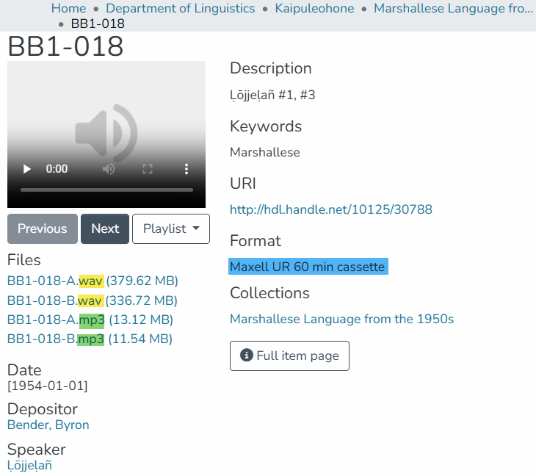
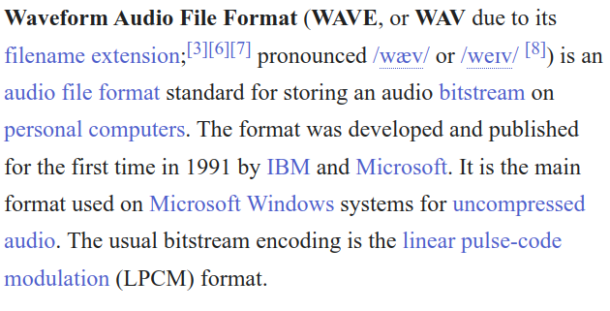
Digitization Example—Kaipuleohone
Format is described in descriptive metadata record as “Maxell UR 60 min cassette”
What is offered are .wav and .mp3 files
MIXED METADATA
Notes:
https://scholarspace.manoa.hawaii.edu/items/2f041c43-4a6c-48a3-ad8a-e17c883b5ae1

Slide 21
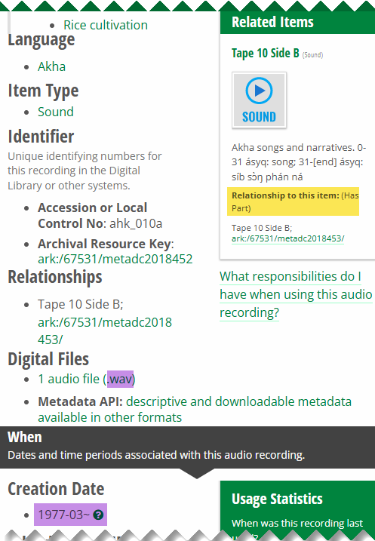
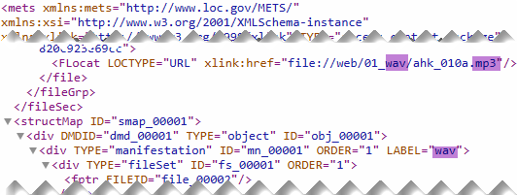
Portion Example—UNT Digital Library
Is Side B a part of Side A?
UNTL descriptive metadata does not specify record scope.
End-user display of UNTL metadata says .wav
METS metadata points to .mp3
MIXED METADATA
Notes:
The Record presents itself as Tape 10 Side A. It seems to describe the Audio File which is a WAV file. But has a creation date of March 1977. EVEN though the wave file format only debuted in 1991. Then for Tape 10 Side B, the relationship is considered a part of SIDE A. How does this match up with what we have learned about expressions and parts of expressions? Do we see a clear case here of the tape being cataloged or the audio file or neither? This seems to be neither a record of an Expression, nor a Manifestation.
Link: https://digital.library.unt.edu/ark:/67531/metadc2018452/
https://digital.library.unt.edu/ark:/67531/metadc2018452/metadata.mets.xml
https://www.iana.org/assignments/media-types/media-types.xhtml#audio

Slide 22
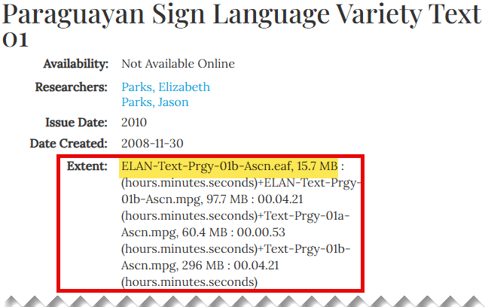
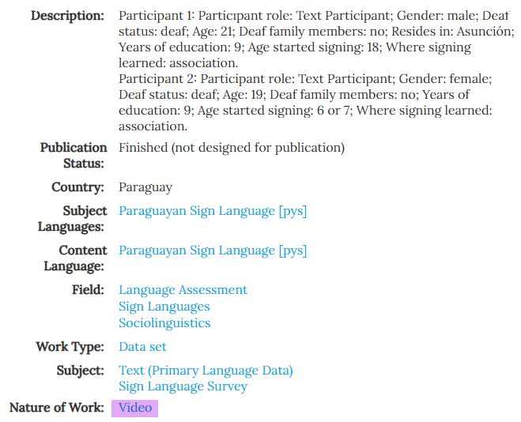
Annotation Example—SIL International
Descriptive metadata states that video is the nature of work – contradicts with ELAN Text in Extent field
Notes:
https://www.sil.org/resources/archives/47522

Slide 23
Benefits
Adoption of LS models for language resources can help improve
Discovery Services
Metadata Compatibility
Citation/ Referencing
More consistency of relationships within and across archives
Within library-operated repositories which often host language archives
More persistent identifiers for better citation capabilities

Slide 24

THE END

Slide 25

Questions/Thoughts
Feel free also to check out our project website
ci.unt.edu/lamlangarctraining

Slide 26
References
Burke, Mary, and Oksana L. Zavalina. 2019. “Exploration of Information Organization in Language Archives.” Proceedings of the Association for Information Science and Technology 56 (1): 364–67. doi:10.1002/pra2.30.
Coyle, Karen. 2022. “Works, Expressions, Manifestations, Items: An Ontology.” The Code4Lib Journal 53 (May). https://journal.code4lib.org/articles/16491.
Huber, Christian. 2023. “Why It Can Be Difficult to Make Historic Language Recordings Accessible: A View from a Corpus of Historic Dialect Recordings.” In Proceedings of the International Workshop on Digital Language Archives: LangArc-2023, edited by Oksana L. Zavalina and Shobhana Lakshmi Chelliah, 15–18. Denton, Texas: University of North Texas. doi:10.12794/langarc2114302.
Johnson, Heidi. 2002. “The Archive of the Indigenous Languages of Latin America: Goals and Visions.” In . Las Palmas, Spain: European Language Resources Association. https://www.mpi.nl/lrec/2002/program.html.
Paterson III, Hugh J. 2021a. “Language Archive Records: Interoperability of Referencing Practices and Metadata Models.” M.A. Thesis, Grand Forks, North Dakota: University of North Dakota. Theses and Dissertations. 3937. University of North Dakota Scholarly Commons. https://commons.und.edu/theses/3937.
———. 2021b. “Audio Artifacts in Language Archives: From Cataloguing to Referencing and Citation.” Presentation Abstract & Video presented at the 2021 Conference of the International Association of Sound and Audiovisual Archives: Closing the gap for a new generation of sound and audiovisual archives, Online, September 27. https://hughandbecky.us/Hugh-CV/talk/2021-audio-artifacts-in-language-archives/.
Riva, Pat, Patrick Le Bœuf, and Maja Žumer, eds. 2017. IFLA Library Reference Model: A Conceptual Model for Bibliographic Information. December 2017. Den Haag, Netherlands: International Federation of Library Associations and Institutions (IFLA). https://www.ifla.org/publications/node/11412.

